Slide 1
Natural Language API

Slide 2
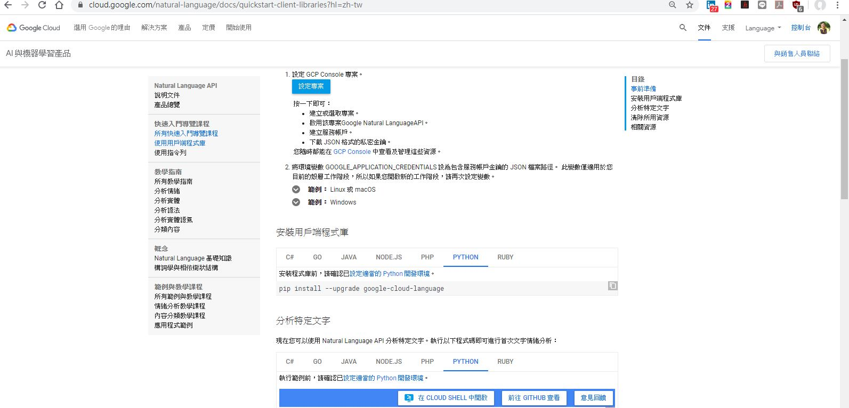
Quick start GCP Quick-Start

Slide 3
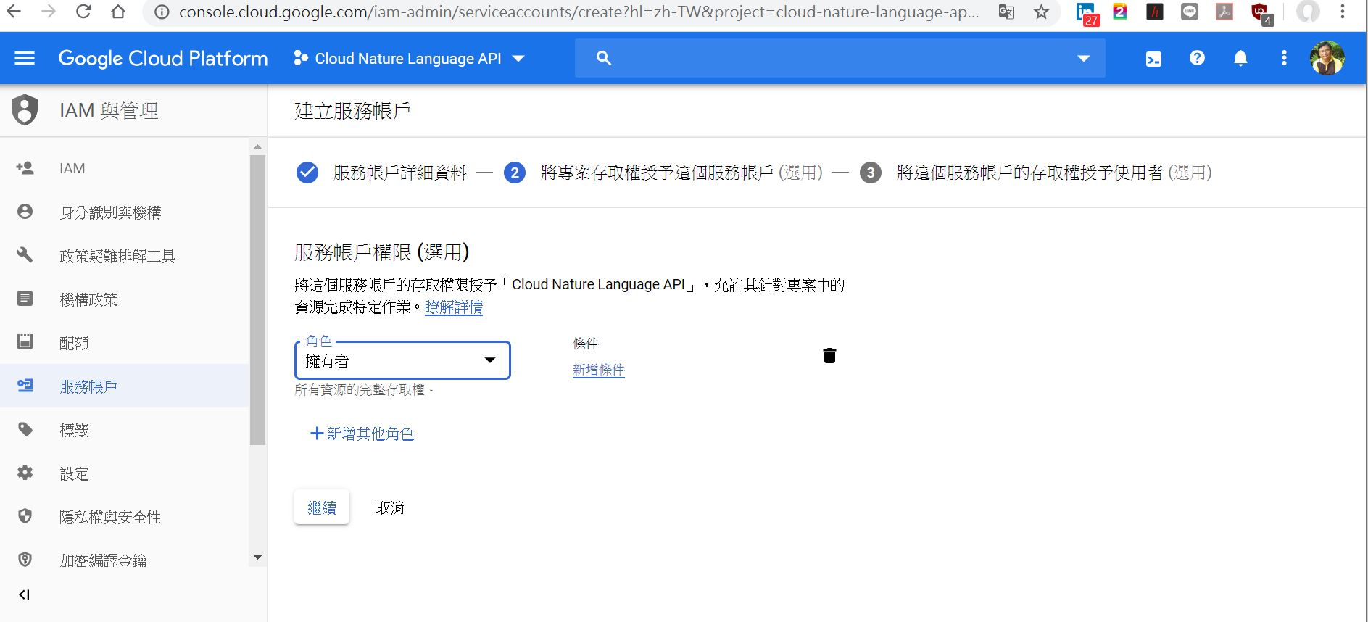
服務帳戶建立

Slide 4
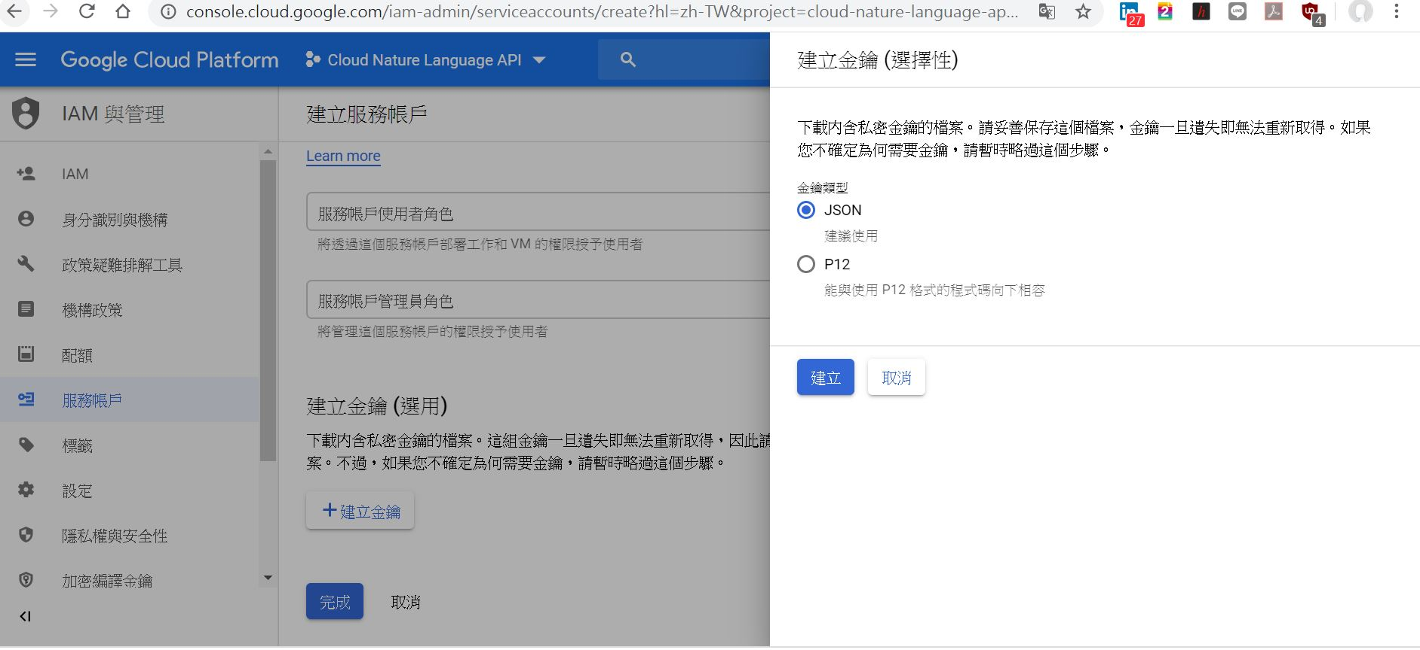
建立金鑰，下載JSON檔

Slide 5
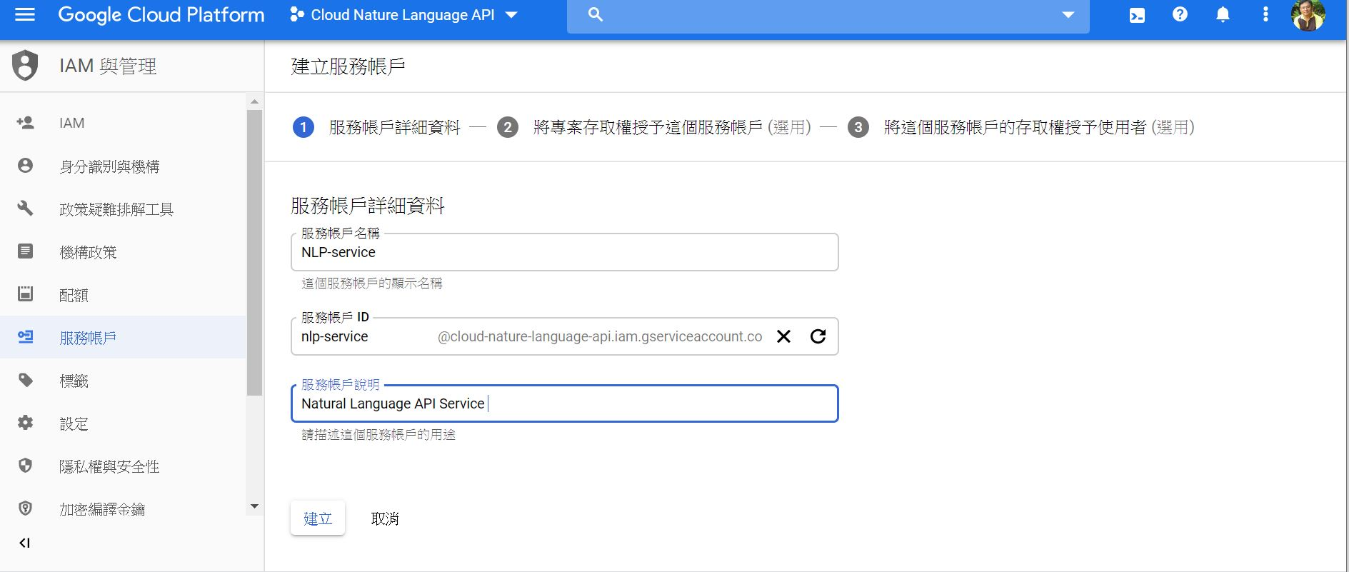

Slide 6
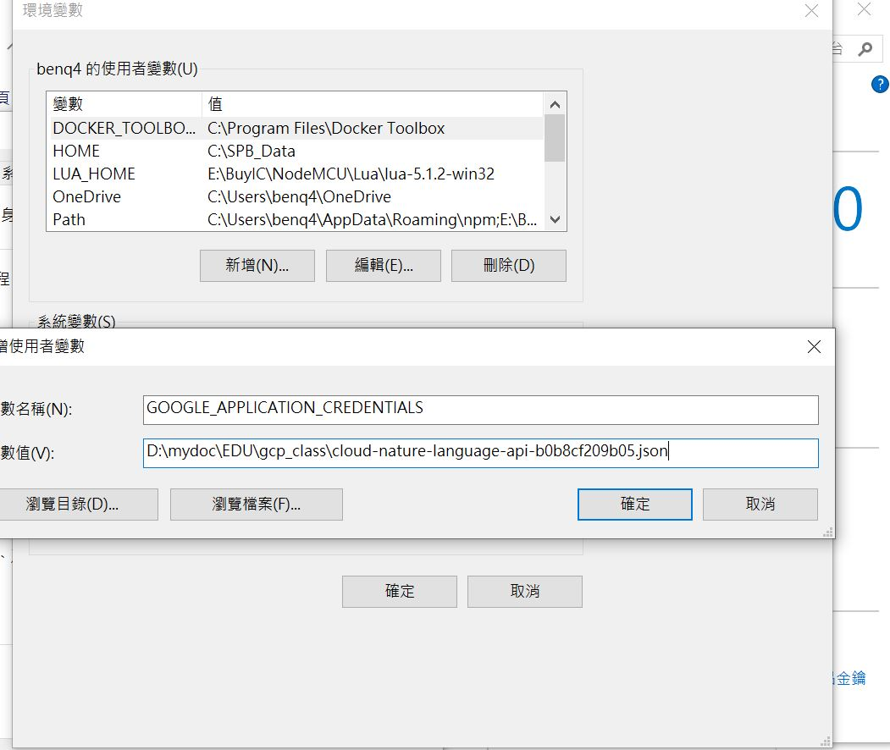
Windows 環境變數加入金鑰路徑 set GOOGLE_APPLICATION_CREDENTIALS=[PATH]

Slide 7
python3 -m pip install iso-639
pip install google-cloud-language
設定python開發環境
安裝用戶端程式庫: pip install --upgrade google-cloud-language
分析特定文字
下載及設定金鑰: IAM與管理➔服務帳戶➔下載金鑰
Windows GCP SDK 安裝設定
=> pip install google-cloud-language

Slide 8
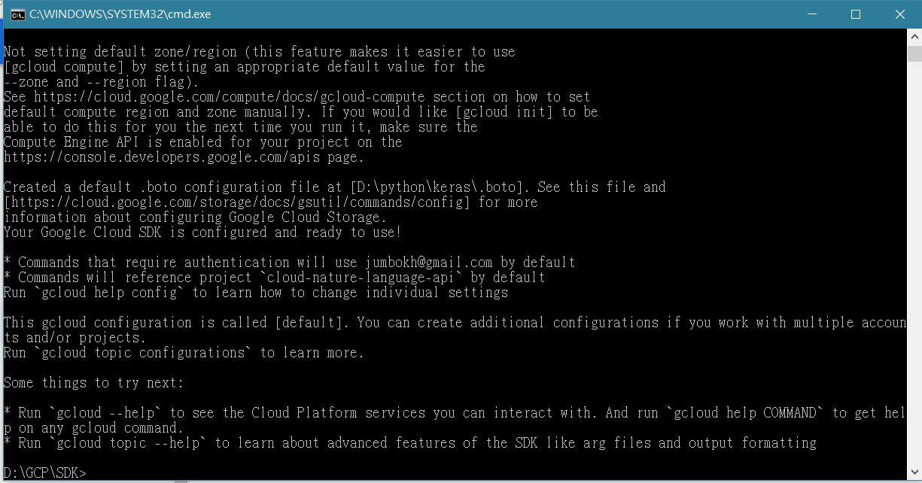
Install GCP sdk

Slide 9
# Imports the Google Cloud client library
from google.cloud import language
from google.cloud.language import enums
from google.cloud.language import types
# Instantiates a client
client = language.LanguageServiceClient()
# The text to analyze
text = u'Hello, world!'
document = types.Document(
content=text,
type=enums.Document.Type.PLAIN_TEXT)
# Detects the sentiment of the text
sentiment = client.analyze_sentiment(document=document).document_sentiment
print('Text: {}'.format(text))
print('Sentiment: {}, {}'.format(sentiment.score, sentiment.magnitude))

Slide 10
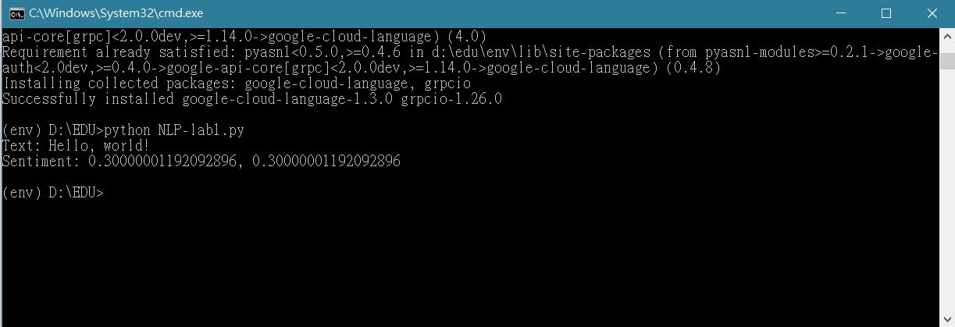
Send message to cloud

